Slide 1


Multiple Dispatch from Julia into Racket
Worked by:
Hansi Seitaj

Slide 2
Introduction
Multiple dispatch is a programming paradigm that allows a function to have different behaviors depending on the types of its arguments.
Julia, a high-performance dynamic programming language, has been praised for its efficient implementation of multiple dispatch, which has enabled developers to write code that is both flexible and performant.
The implementation is made in Racket programming language without using an external library or module.

Slide 3
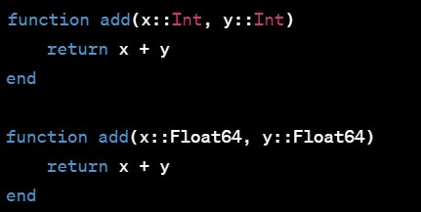
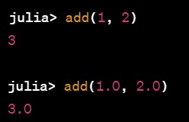
Examples of Multiple Dispatch in Julia
In this example, we have defined two functions with the same name add. However, they differ in the types of their arguments. The first add function takes two integers as arguments, and the second add function takes two floating-point numbers.
When you call the add function, Julia will dispatch to the appropriate method based on the types of the arguments that you pass in:

Slide 4
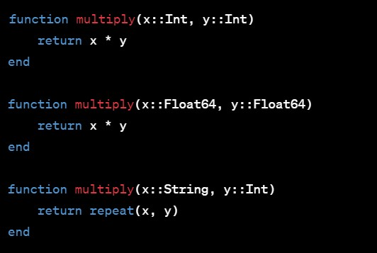
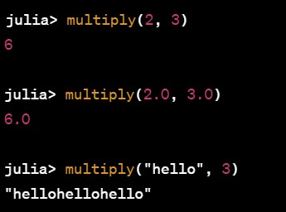
Examples of Multiple Dispatch in Julia
When we call multiply with two integers, Julia dispatches to the first multiply method. When we call multiply with two floating-point numbers, Julia dispatches to the second multiply method. Finally, when we call multiply with a string and an integer, Julia dispatches to the third multiply method.

Slide 5
The difference between multiple dispatch and parameter overload
Multiple dispatch and parameter overload are approaches to function dispatch.
Parameter overload is based on the number or type of function arguments, while multiple dispatch is based on the types of all arguments involved in the function call.
Parameter overload uses methods defined with specific parameter sets, while multiple dispatch uses methods defined with specific combinations of argument types.
Multiple dispatch allows for more flexibility and extensibility in function definition.
Parameter overload is commonly used in languages like Java, while multiple dispatch is commonly used in languages like Julia.

Slide 6
Instructions to run the program
Run these commands :
Please install DrRacket and download Racket programming language
Download the provided file and open it in DrRacket
Run the program and test other cases in the DrRacket console.
The project can be found in my GitHub repository (hseitaj).

Slide 7
Project Demonstration

Slide 8
Conclusion
Overall, we can define methods with different numbers of arguments, if the types of the arguments are different.
This allows for great flexibility in function definition and behavior based on argument types.
The result is a powerful set of tools that allow developers to write code that is both elegant and efficient, and which can be easily extended and customized as needed.
However, in this final project I decided to implement this amazing feature in Racket from scratch.

Slide 9


